Slide 1





Database Fundamentals And
Microsoft Access
For Beginners
5 Tables in MS Access
Prepared By :
Said Fawzy
Manager of Information Center
Tendering Department
Arab Contractors

Slide 2
Contents
Plan and design Customer Database
Create Tables in ms access

Slide 3
Task 6 : Create ERD for Customer DB
We need to collect data about:
  Customer: ID, Name, Address (address1, Address2, City, State, Zip) , Phone ,Email, Active State.
  Employee: ID, Name (First, Last), Extension
  Category: ID, Name.
  Product: ID, Name, Price, Manual
  Order: ID, Order Date, Ship Date, Quantity of Each Product.

Slide 4
Rules:
Each order is for one customer.
A customer may have many orders.
An Employee can serve many customers.
A customer is served by one employee.
Products are classified into categories.

Slide 5
Category
Employee
Order
Product
Customer

Slide 6

Address2
Category
State
Address1
City
Employee
Zip
Order
Name
Address
ID
Email
Phone
Active
Product
Customer

Slide 7
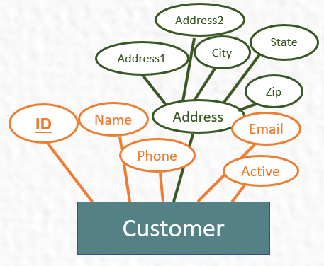
Address2
Category
State
Address1
City
Employee
Zip
Order
Name
Address
ID
Email
Phone
Active
Product
Customer

Slide 8
Category
Employee
Order
Product

Slide 9
First
Last
Category
ID
Name
Ext.
Order
Employee
Product

Slide 10
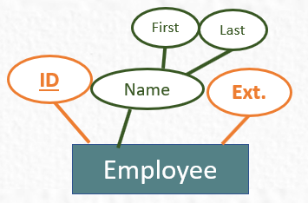
First
First
Last
Last
Category
ID
ID
Ext.
Name
Ext.
Name
Order
Employee
Employee
Product

Slide 11
Category
Order
Product

Slide 12
Category
O.Date
S.Date
ID
Order
Product

Slide 13
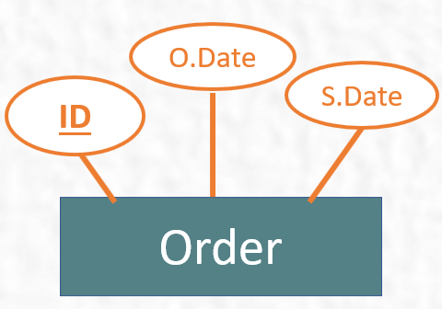
Category
O.Date
S.Date
ID
Order
Product

Slide 14
Category
Product

Slide 15
ID
Name
Category
Product

Slide 16
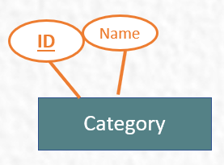
ID
Name
Category
Product

Slide 17
Product

Slide 18
Product

Slide 19
Name
ID
Price
Product

Slide 20
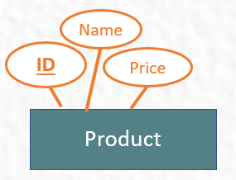
Name
ID
Price
Product

Slide 23
1
Resb.
M

Slide 24
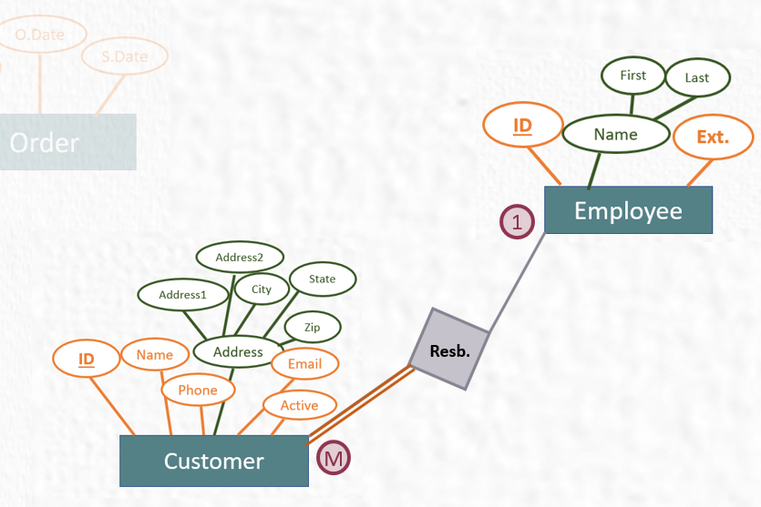
1
Resb.
M

Slide 25
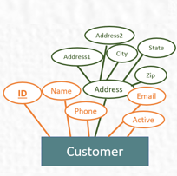
M
Has
1

Slide 26
1
Has
M

Slide 27
Qty
M
Has
M

Slide 28
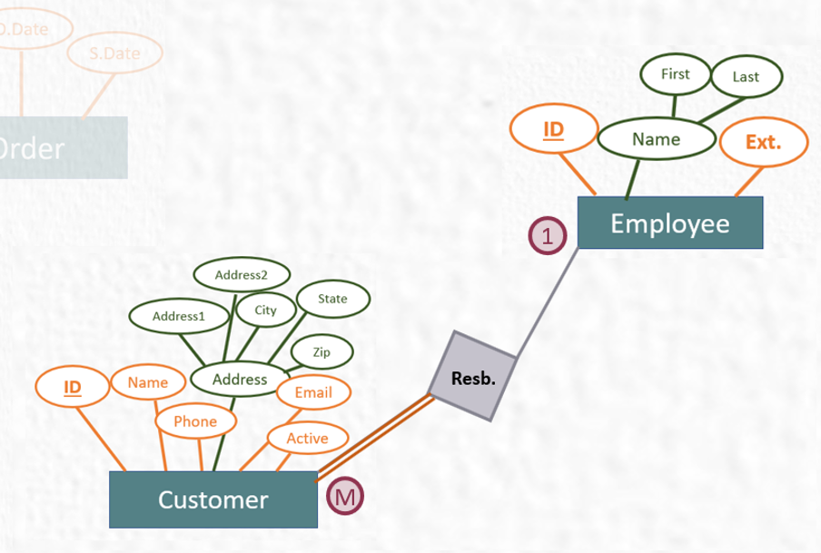
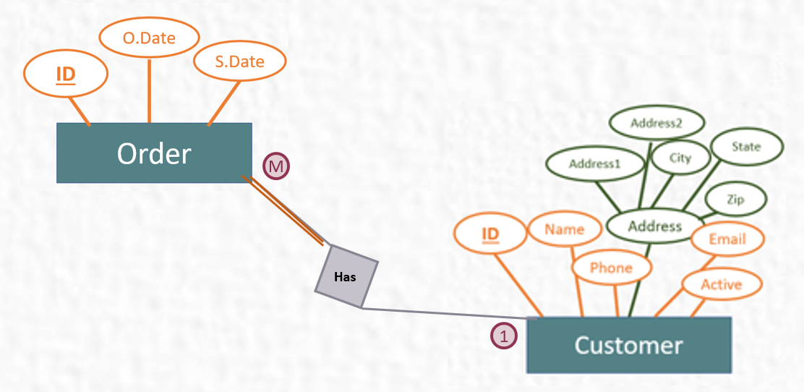
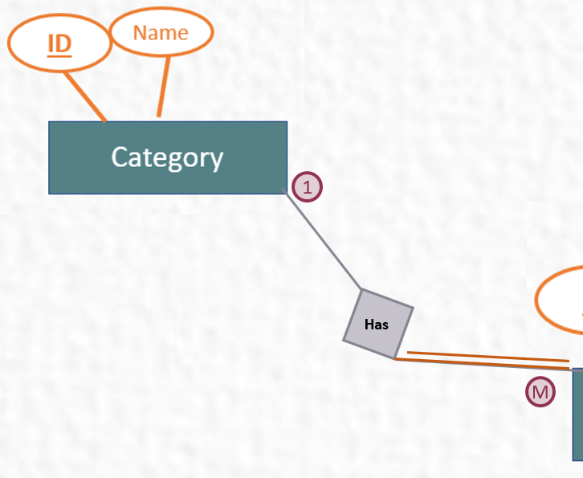
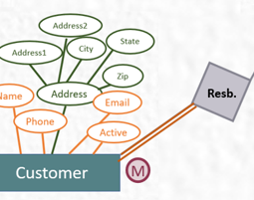
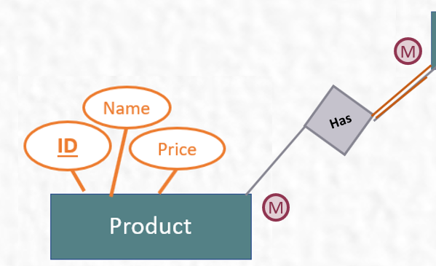


Slide 29

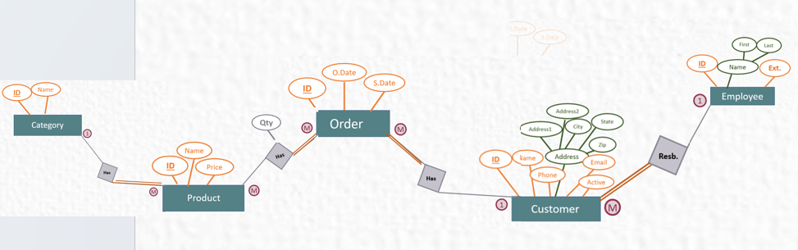

Slide 30
Task 6 : Logical Model
Convert your design to logical Model

Slide 31
Cust. : ( ID, Name, Phone ,Address1,Address2,City,State,Zip,Email, Active)

Slide 32
Cust. : ( ID, Name, Phone ,Address1,Address2,City,State,Zip,Email, Active)
Emp. : ( ID, Name,FName,LName,Ext.)

Slide 33
Cust. : ( ID, Name, Phone ,Address1,Address2,City,State,Zip,Email, Active)
Emp. : ( ID, Name,FName,LName,Ext.)
Order: ( ID,O.Date,S.Date)

Slide 34
Cust. : ( ID, Name, Phone ,Address1,Address2,City,State,Zip,Email, Active)
Emp. : ( ID, Name,FName,LName,Ext.)
Order: ( ID,O.Date,S.Date)
Category : ( ID,Name)

Slide 35
Cust. : ( ID, Name, Phone ,Address1,Address2,City,State,Zip,Email, Active)
Emp. : ( ID, Name,FName,LName,Ext.)
Order: ( ID,O.Date,S.Date)
Category : ( ID,Name)
Product: ( ID, Name,Price)

Slide 36
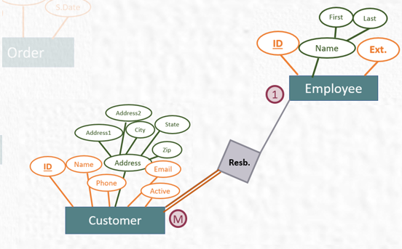
Cust. : ( ID, Name, Phone ,Address1,Address2,City,State,Zip,Email, Active)
,EmpID)
Emp. : ( ID, Name,FName,LName,Ext.)
Order: ( ID,O.Date,S.Date)
Category : ( ID,Name)
Product: ( ID, Name,Price)

Slide 37
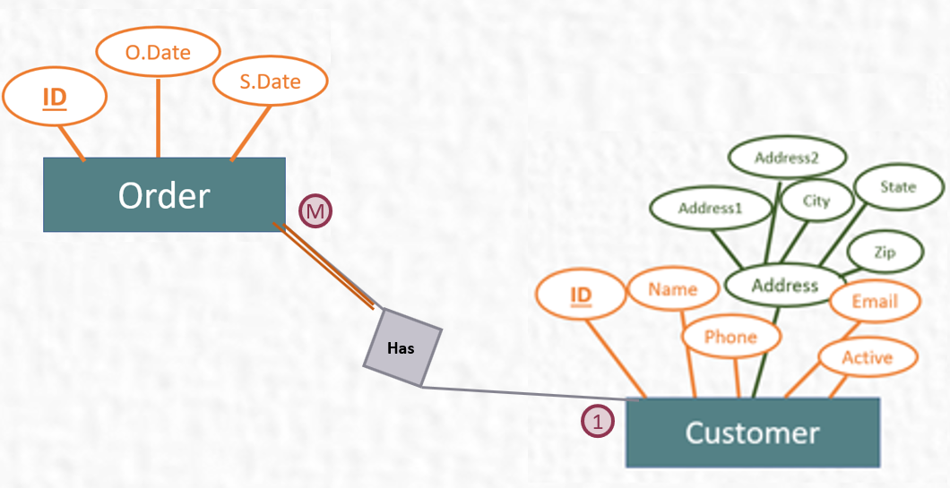
Cust. : ( ID, Name, Phone ,Address1,Address2,City,State,Zip,Email, Active)
,EmpID)
Emp. : ( ID, Name,FName,LName,Ext.)
Order: ( ID,O.Date,S.Date)
,CustID)
Category : ( ID,Name)
Product: ( ID, Name,Price)

Slide 38
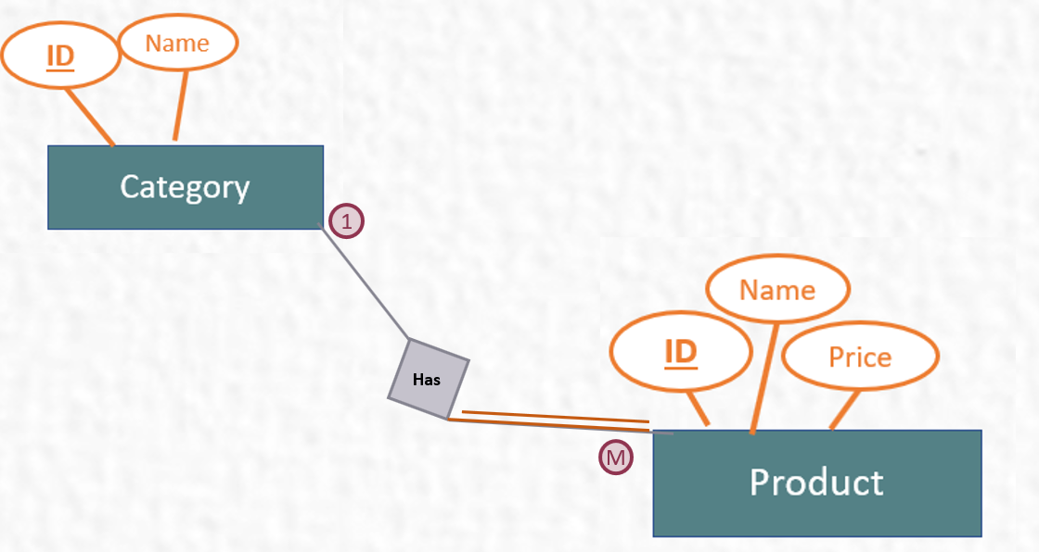
Cust. : ( ID, Name, Phone ,Address1,Address2,City,State,Zip,Email, Active)
,EmpID)
Emp. : ( ID, Name,FName,LName,Ext.)
Order: ( ID,O.Date,S.Date)
,CustD)
Category : ( ID,Name)
Product: ( ID, Name,Price)
,CategoryID)

Slide 39
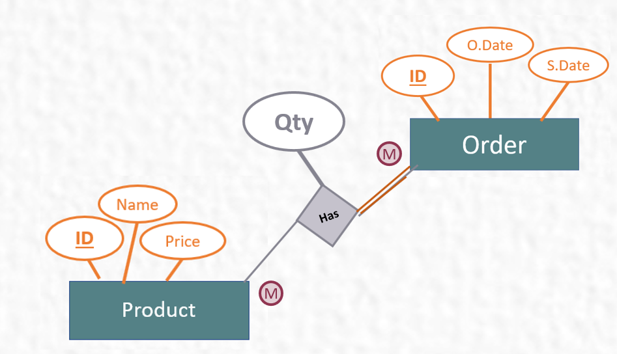
Cust. : ( ID, Name, Phone ,Address1,Address2,City,State,Zip,Email, Active)
,EmpID)
Emp. : ( ID, Name,FName,LName,Ext.)
Order: ( ID,O.Date,S.Date)
,CustD)
Category : ( ID,Name)
Product: ( ID, Name,Price)
,CategoryID)
,ProductID
,Qty
Order_Details: ( )
OrderID

Slide 40
Cust. : ( ID, Name, Phone ,Address1,Address2,City,State,Zip,Email, Active)
,EmpID)
Emp. : ( ID, Name,FName,LName,Ext.)
Order: ( ID,O.Date,S.Date)
,CustD)
Category : ( ID,Name)
Product: ( ID, Name,Price)
,CategoryID)
OrderID
,ProductID
,Qty
Order_Details: ( )

Slide 41
Task 8: Create Tables in MS Access
Create your tables in MS Access

Slide 42
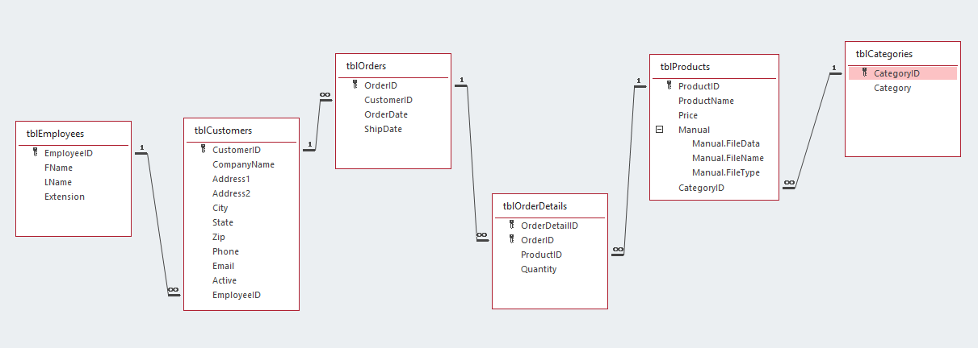
Junction Table

Slide 43


